Slide 1



Predicting the Traffic-Jam: Congestion-Aware Routing
Proposed by:
Niharika Shrivastava (IIIT, Allahabad)
Malika Meghjani (SUTD, Singapore)
Presented by:
Niharika Shrivastava
Notes:
Hello everyone! I am Niharika Shrivastava and I’m going to tell you about our framework that predicts traffic jam, and provides intelligent congestion-aware routes so that we can avoid situations like these.

Slide 2
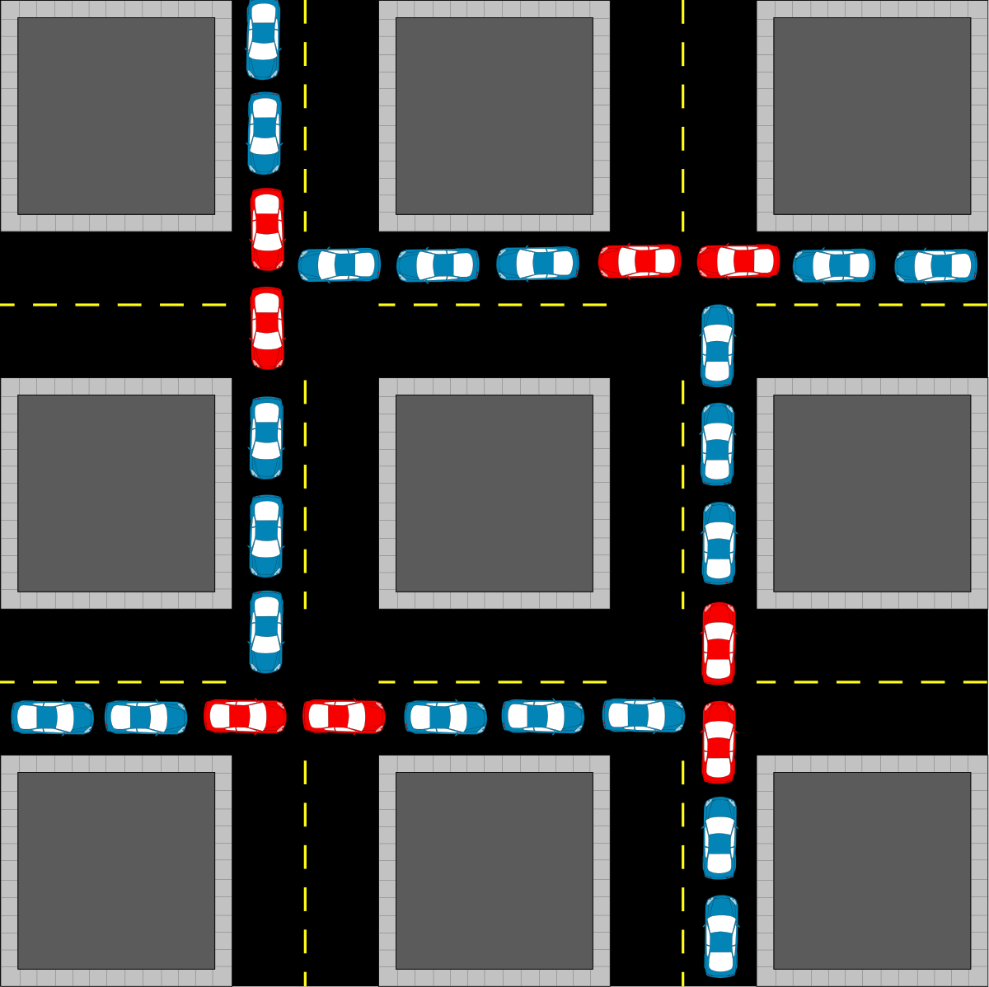
Background
Everyone prefers shortest distance route
No. of vehicles exponentially increasing
Capacity of roads ⟶ CONSTANT!
Increasing travel times
Under-utilization of a city’s road network.
Fig. 1: Gridlock on road intersections due to unintelligent routing
Notes:
The problem of congestion in road networks arises because every passenger inherently opts for the shortest distance route from their source to destination. With an increase in the no. of vehicles over the years, and capacity of roads being approximately constant, road blockages occur and travel times increase drastically.

Slide 3

Use multi-class fleets instead?
Break a customer trip into 3 classes:
First mile:
Last mile:
Middle mile: Covers ~90% of the trips using fast-speed cars or public transports.
Use cycles, scooters, walking on pedestrian paths
Fig. 2: Customer trip performed using a multi-class fleet of vehicles
Notes:
By using all three classes in an optimal combination, customers can maneuver through crowded paths and congested roads with ease. This also gives customers flexibility in choosing their preferred mode of transport based on accessibility and cost.
Eg: 250m walking, bus for 15 min, 400 scooter

Slide 4
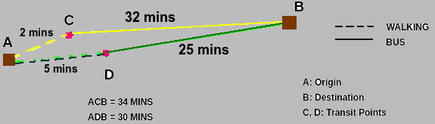
Formulating our problem
Route customer trips in a congestion-aware manner using a multi-class fleet of vehicles.
Provides optimal transit points for each trip.
Create a social model.
Wardrop User Equilibrium
Wardrop System Equilibrium
✅
Fig. 3: A multi-class setup (walking + bus). D is the optimal transit point for minimum trip time

Slide 5
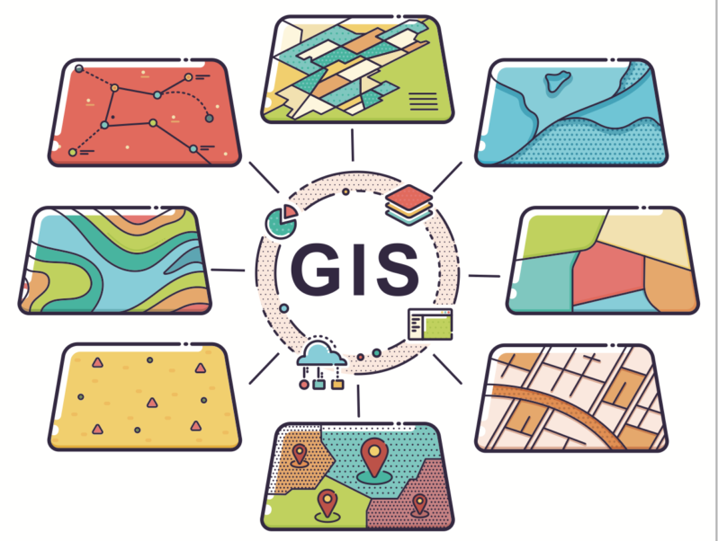
Geographic Information System [GIS]
It’s a computer system for capturing, storing, checking, and displaying data related to positions on Earth’s surface.

Slide 6
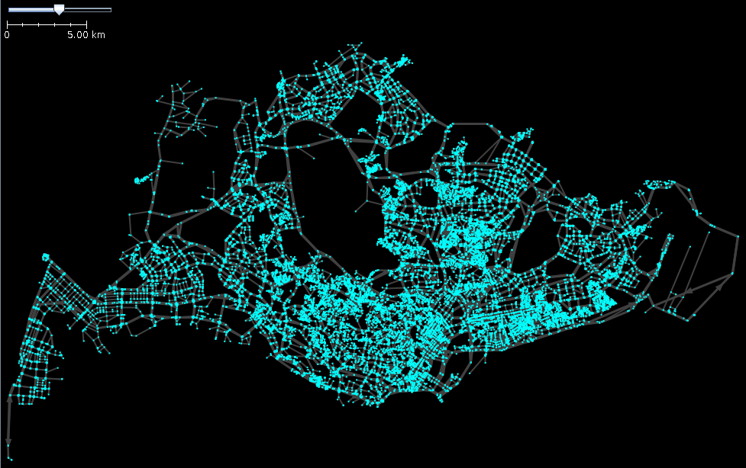
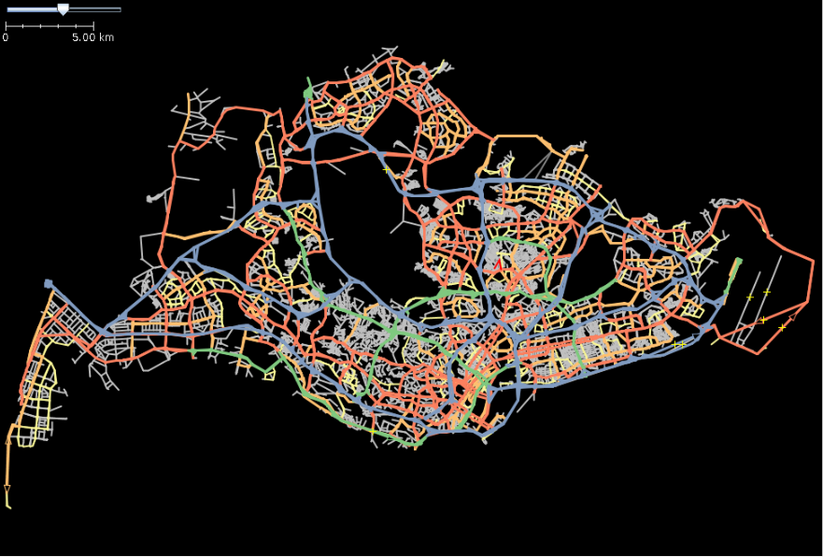
Python GIS Libraries
OSMNx:
Retrieve, model, analyze, and visualize OpenStreetMap street networks and other spatial data.
Fig. 5: Nodes (V)
Fig. 6: Edges (E)

Slide 7
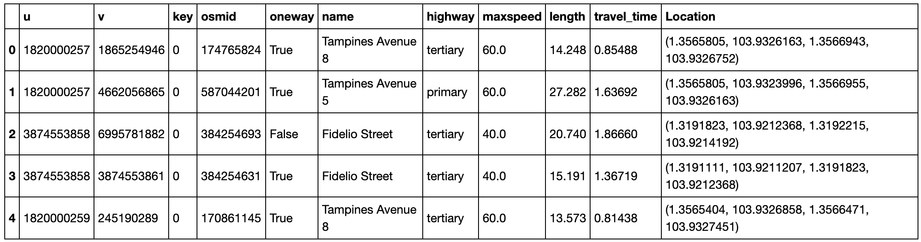
Python GIS Libraries
GeoPandas:
Extends the datatypes used by pandas to allow spatial operations on geometric types.
Fig. 4: Edges Dataframe

Slide 8
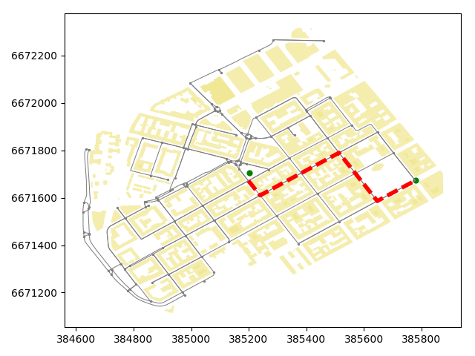
Python GIS Libraries
NetworkX:
Create, manipulate, and study the structure, dynamics, and functions of complex networks.

Slide 9
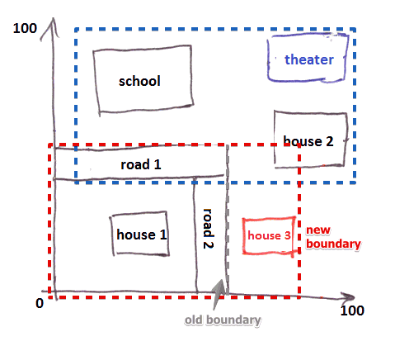
Python GIS Libraries
Rtree:
Provides advanced spatial indexing features like nearest neighbor search, intersection search

Slide 10
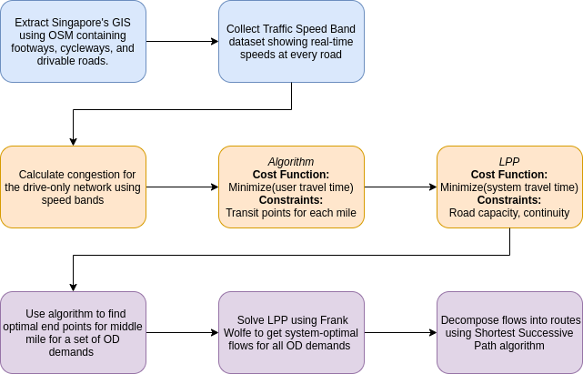
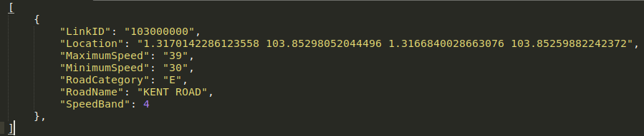
What are we doing?
Fig. 4: Project Life Cycle

Slide 11
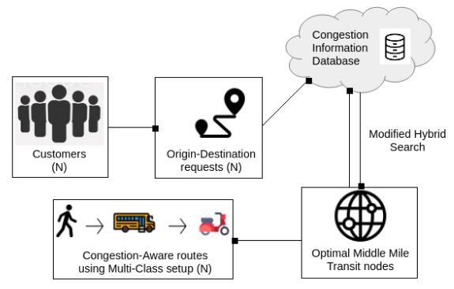
Architecture
Frank-Wolfe Optimizer
Fig. 10: Workflow

Slide 12
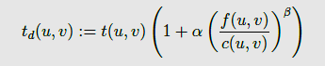
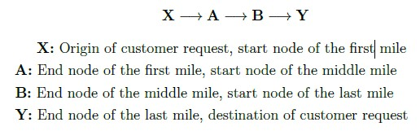
Implementation
Compute Congestion:
Avail. Road Capacity ⋉ 1/(No. of vehicles on road)
⋉ 1/(Travel time on road)
α = 0.15, β = 4
t(u,v) = Free-flow time
t_{d}(u,v) = Actual time after traffic congestion
Compute middle mile transit nodes:
Fig. 8: Bureau of Public Roads Heuristic (BPR)
Fig. 9: A and B are middle mile transit points

Slide 13



Implementation: Algorithm 1
WALKING
Fig. 9: How assignment is done
BUS
D
C
B
E
500M radius
500M radius
A
F
SOURCE
DESTINATION

Slide 14
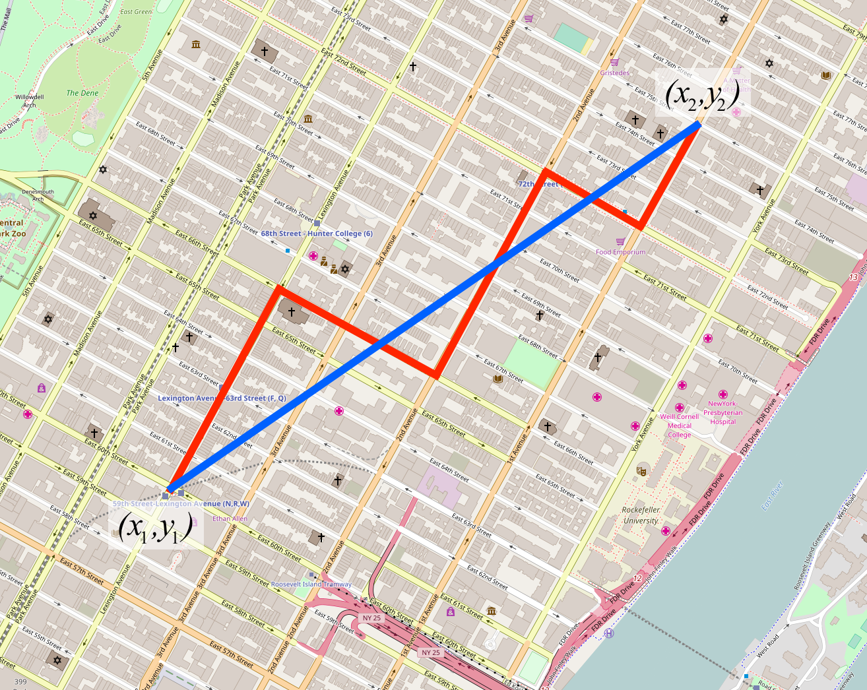
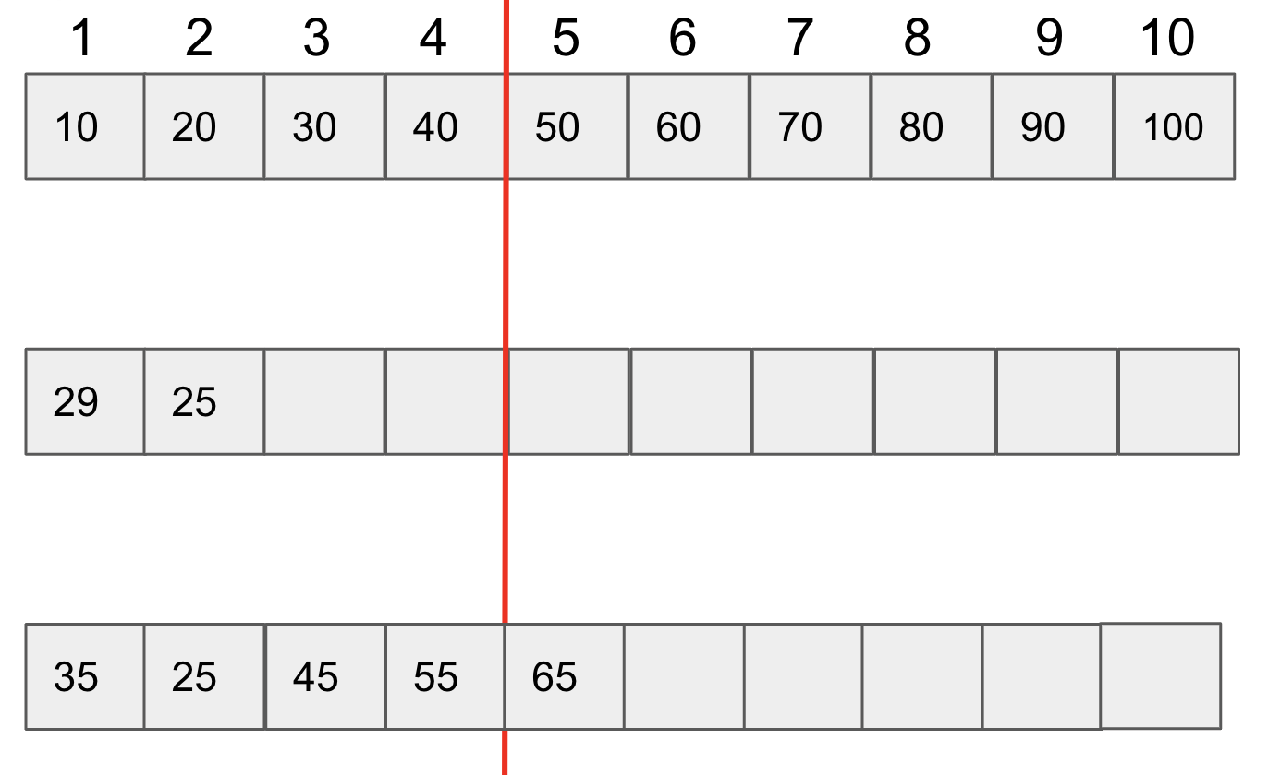
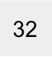
Algorithm 2: Modified Hybrid Search
N = 10
Cutoff = Ceil(N/e) = 4th element (Secretary Problem)
Decider = Cutoff + 1 = 5th element
Case 1: Actual distance < next euclidean distance
No. of queries = 2 = 80% reduction
Case 2: Min pair < or > Decider
No. of queries = 5 = 50% Reduction
Sorted travel-time on Euclidean Dist.:
Case 1:
Case 2:
or
60
55
63
65
52

Slide 15
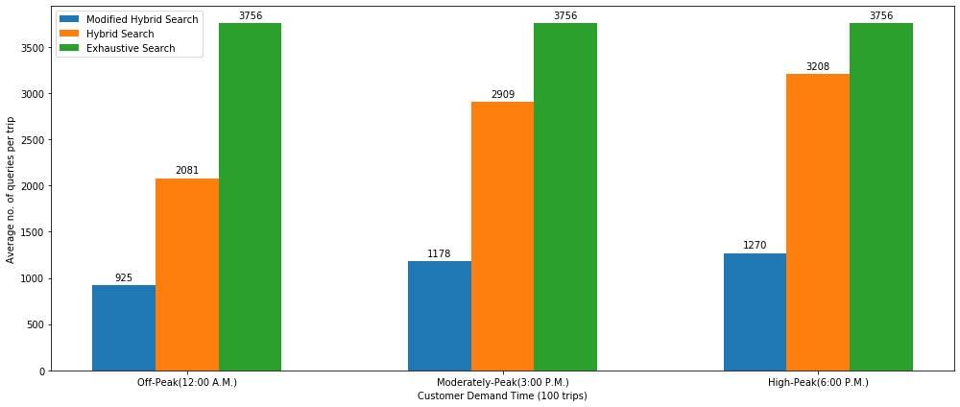
Any Proof? -I: Comparison b/w searches
Modified Hybrid Search outperforms the traditional Exhaustive Search and Hybrid Search
with a 70.07 % reduction in queries, and
is highly efficient with negligible average delay of 4.67 secs.

Slide 16
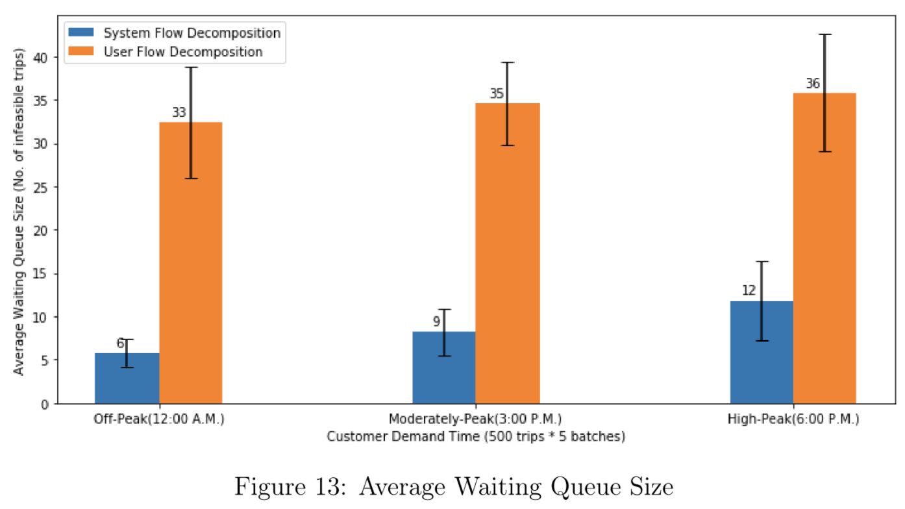
Proof-II: Multi-Class System Equilibrium V.S. Single-Class User Equilibrium
Waiting Queue Size:
0% congestion rate at all times with better road network utilization.
% Average Waiting Queue Size Reduction = 74.26%

Slide 17
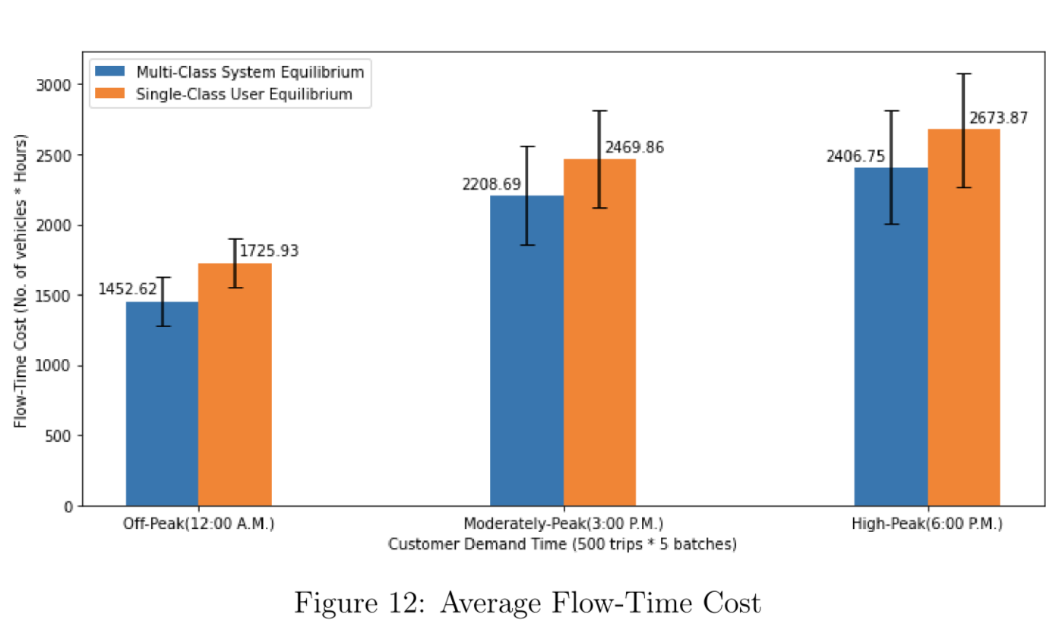
Proof-II: Multi-Class System Equilibrium V.S. Single-Class User Equilibrium
Flow-Time Cost:
Pedestrianized a very small % of the entire trip (up to 1KM).
% Average Flow-Cost Reduction = 12.13% = 33 minutes/trip

Slide 18
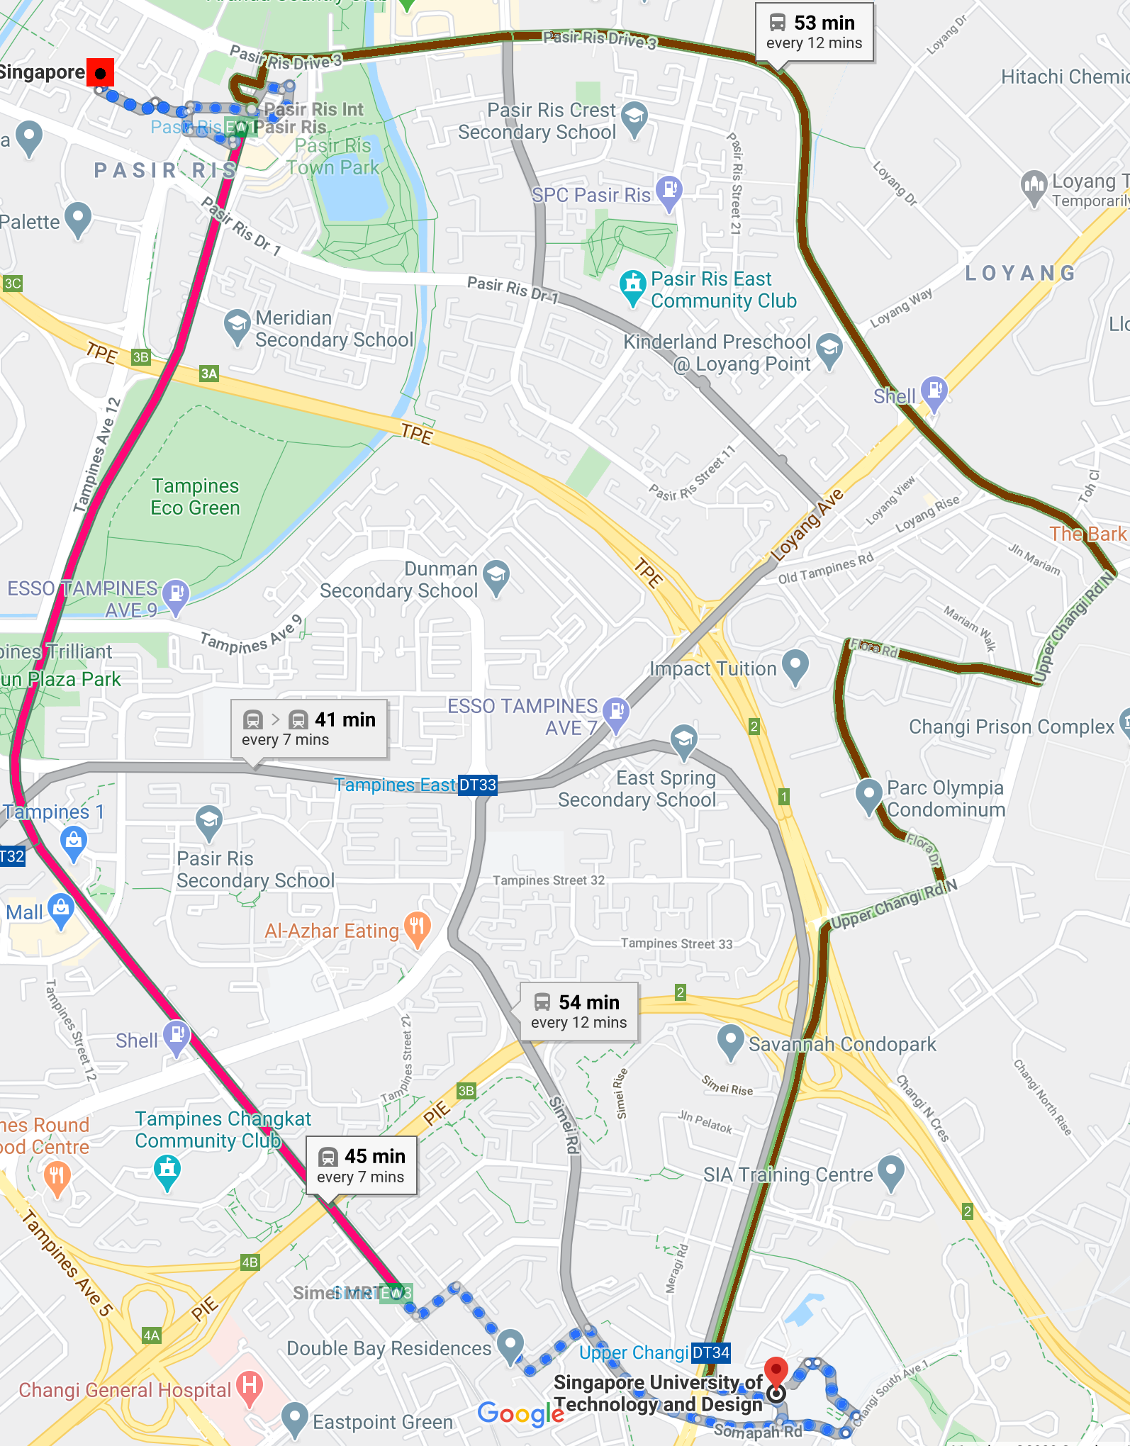
Multi-Class VS Google Maps
Solid brown lines: Path recommended by Google Maps ⓒ
First + Last mile = 21 mins of walking
Total trip time = 53 mins.
Solid red lines: Path recommended by our congestion-aware multi-class framework
First + Last mile = 33 mins of walking
Total trip time = 45 mins.
By increasing the usage of pedestrian networks slightly, overall trip times can be reduced.

Slide 19
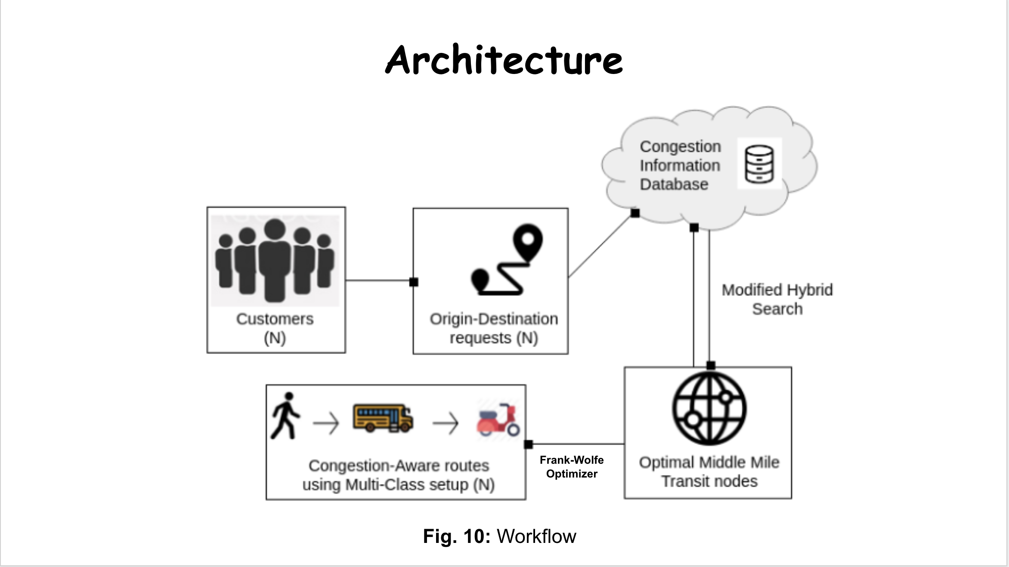
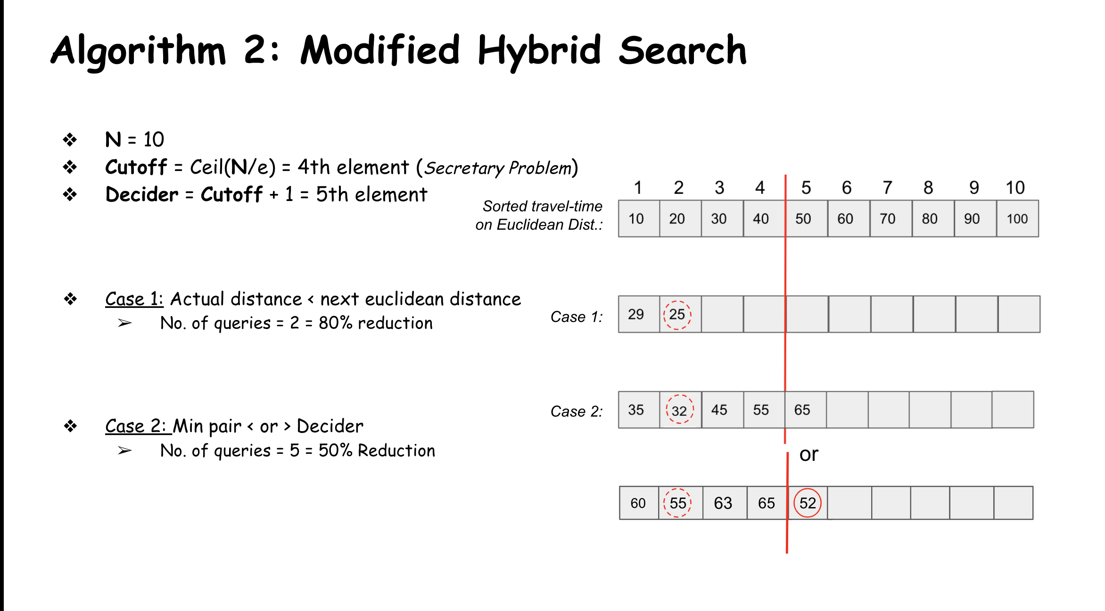
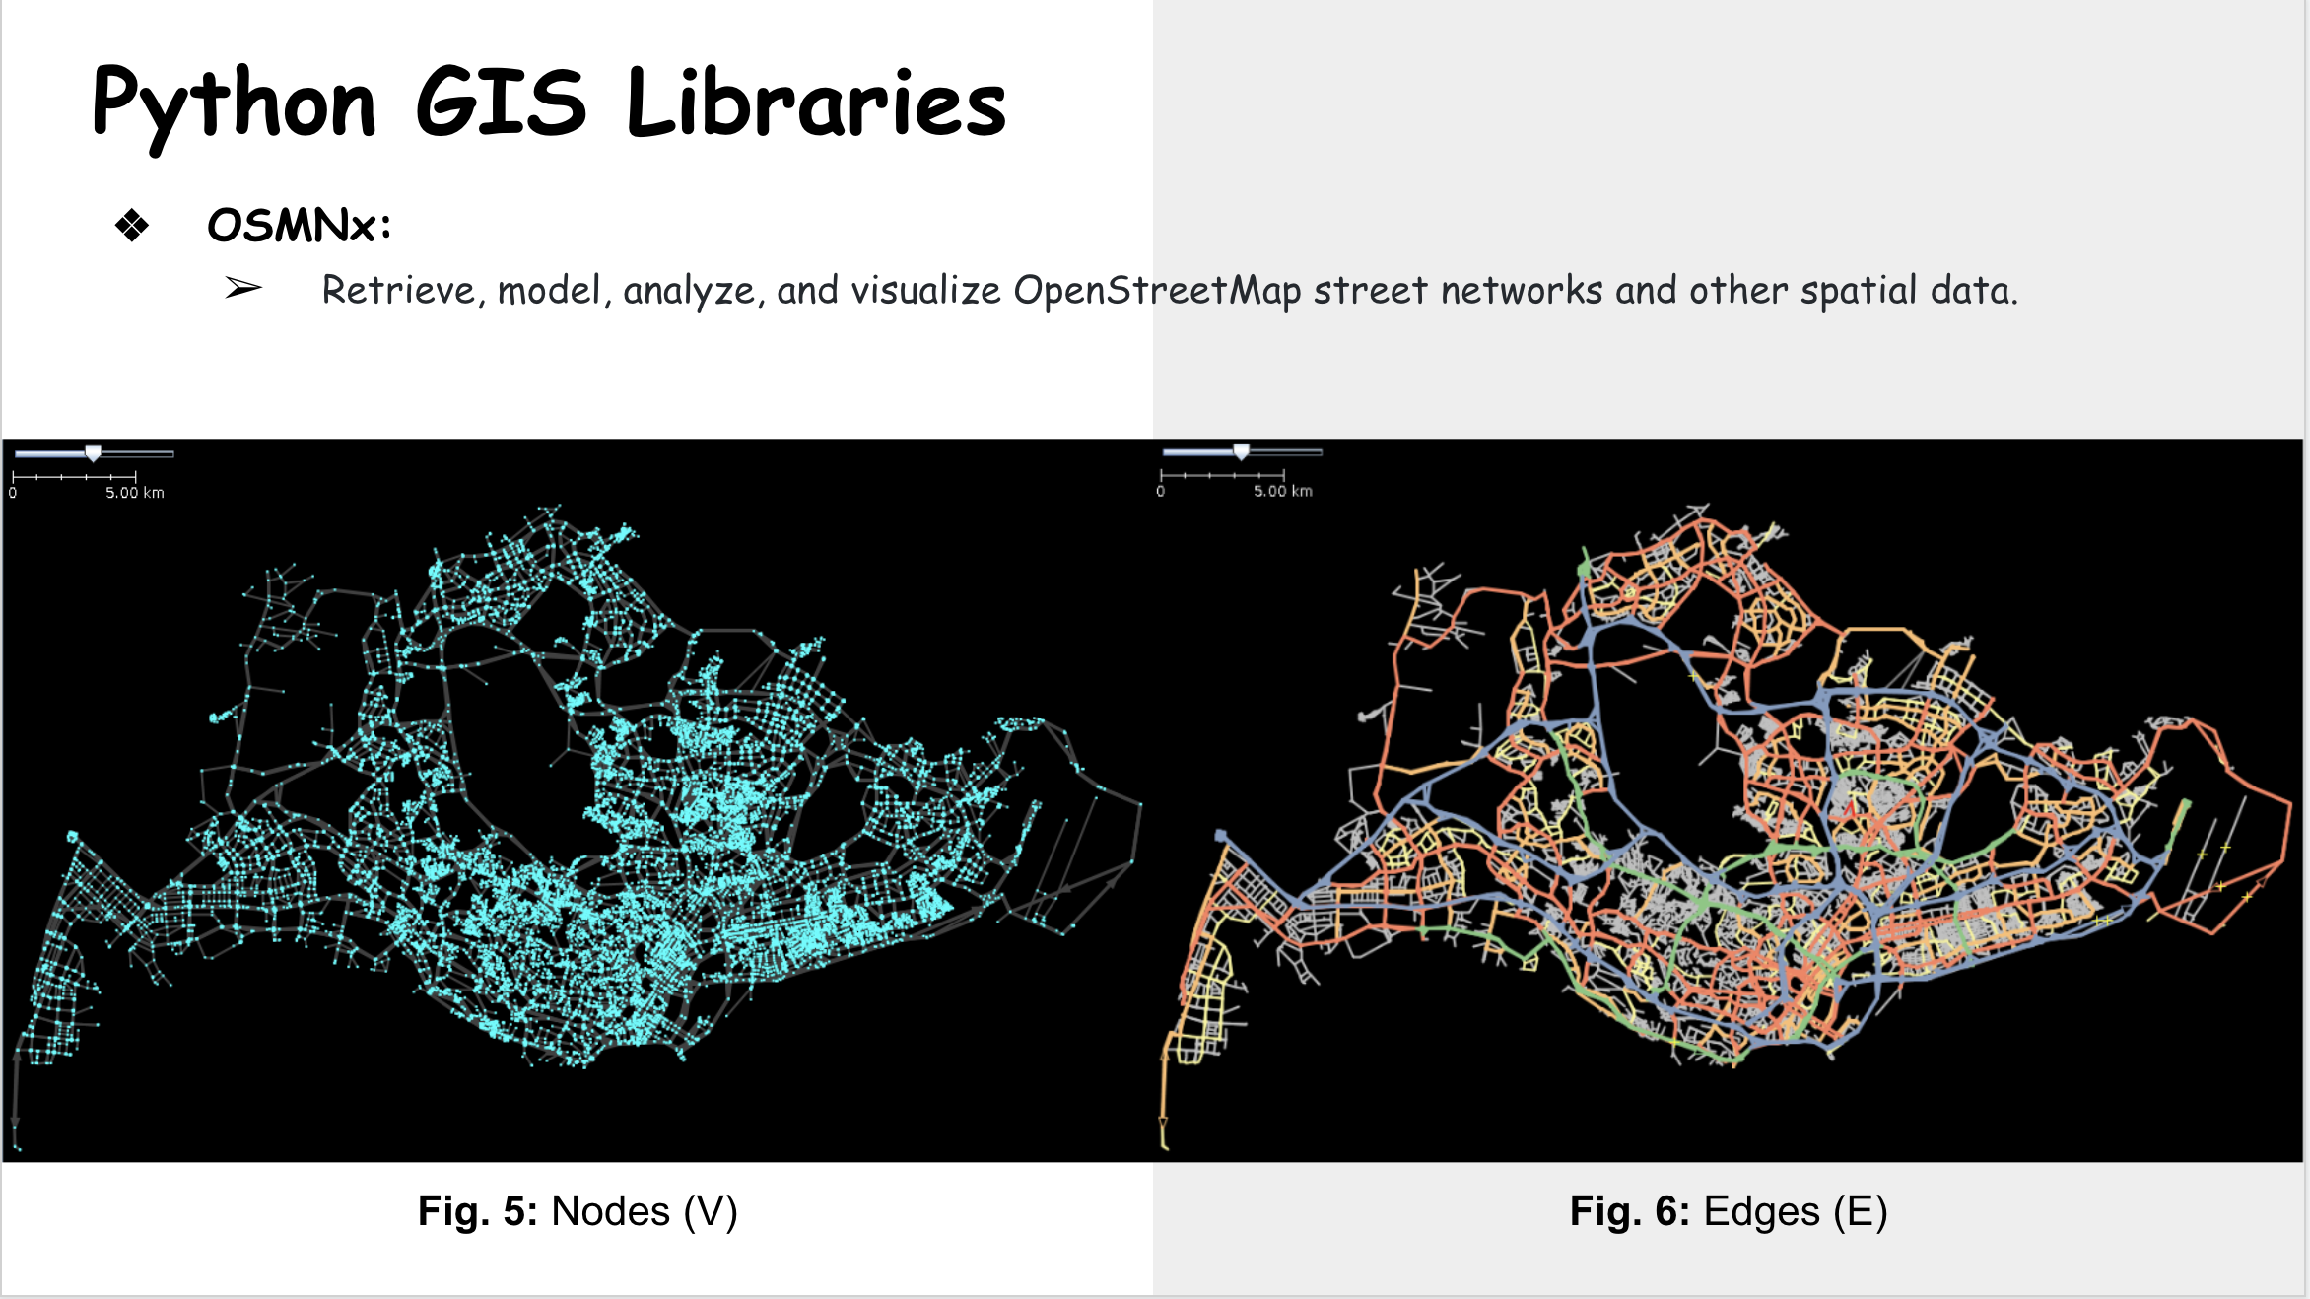
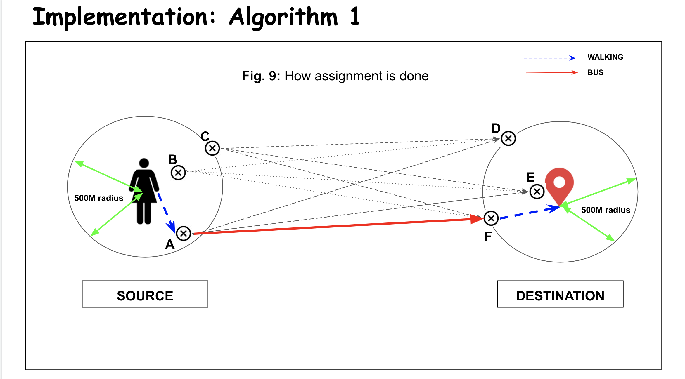
Summarizing in case you slept!

Slide 20
References
[1] B. Templeton, “Traffic congestion and capacity” 2010.
[2] M. Barnard, “Autonomous cars likely to increase congestion,” 2016.
[3] M. Meghjani, S. D. Pendleton, K. Anna, Marczuk, Y. Hong Eng, X. Shen, M. H, J. Ang, and D. Rus, “Multi-class fleet sizing and mobility on demand service,” Complex Systems Design Management Asia, 2018
[4] F. Rossi, R. Zhang, Y. Hindy, and M. Pavone, “Routing autonomous vehicles in congested transportation networks: structural properties and coordination algorithms,” Springer Link: Autonomous Robots (May), 2018.
[5] J. G. Wardrop, “Some theoretical aspects of road traffic research,” Proceedings of the Institution of Civil Engineers, 1952.
[6] V. Pillac, M. Gendreau, C. Guéret, and A. Medaglia, “A review of dynamic vehicle routing problems,” Eur J Oper Res, 2013.
[7] Wikipedia, “Wardrop equilibria,” 1952.
[8] S. Wollenstein-Betech, A. Houshmand, M. Salazar, M. Pavone, C. Cassandras, and I. Paschalidis, “Congestion-aware routing and rebalancing of autonomous mobility-on-demand systems in mixed traffic,” 2020
[9] M. Frank and P. Wolfe, “Frank-wolfe algorithm,” Frank-Wolfe algorithm Wikipedia, 1956.
[10] J. Dibbelt, B. Strasser, and D. Wagner, “Customizable contraction hierarchies,” Journal of Experimental Algorithmics, 2016.
[11] K. Solovey, M. Salazar, and M. Pavone, “Scalable and congestion-aware routing for autonomous mobility-on-demand via frank-wolfe optimization,” 2019.
[12] M. Meghjani, S. Manjanna, and G. Dudek, “Fast and efficient rendezvous in street networks,” IEEE/RSJ International Conference on Intelligent Robots and Systems (IROS), 2016
[13] OpenStreetmap and Wiki, “Openstreetmaps,” 2004.
[14] Government, of, and Singapore, “Lta datamall,” 2020.
[15] TopCoder, “Data science algorithms: Successive shortest path,”
[16] P. Freeman, “The secretary problem and its extensions: A review,” International Statistical Review / Revue Internationale de Statistique, 1983.
[17] Daisik, “Pytrans/urban network analysis,” 2018.
[18] T. N. for Research Core Team, “Transportation networks for research,”

Slide 21


